Slide 1
Sequence Modelling

Slide 2
What is sequence modelling
Interpret, predict or generate any type of sequential data such as audio, video and text
There are broadly two different modelling
Sequence to vector
Sequence to sequence
Sequence to vector modelling have been handled by many classical machine learning approaches
One of the greatest contribution of deep learning is in the area of sequence to sequence modelling

Slide 3
Applications
Speech recognition
Audio clio (seq) to text transcript (seq)
Sentiment classification
Text sentence (seq) to category (vector)
Machine translation
Text in source language (seq) to text in another language (seq)
Identify – DNA sequencing, NER, Video activity recognition

Slide 4
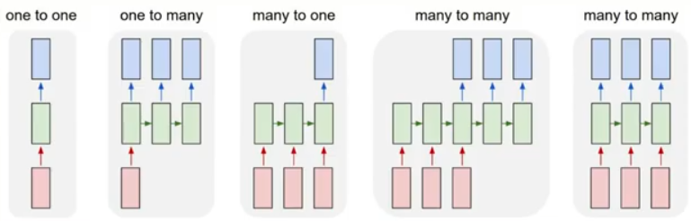
Different types of seq to seq model

Slide 5
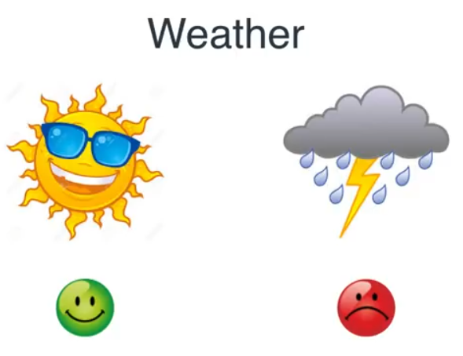
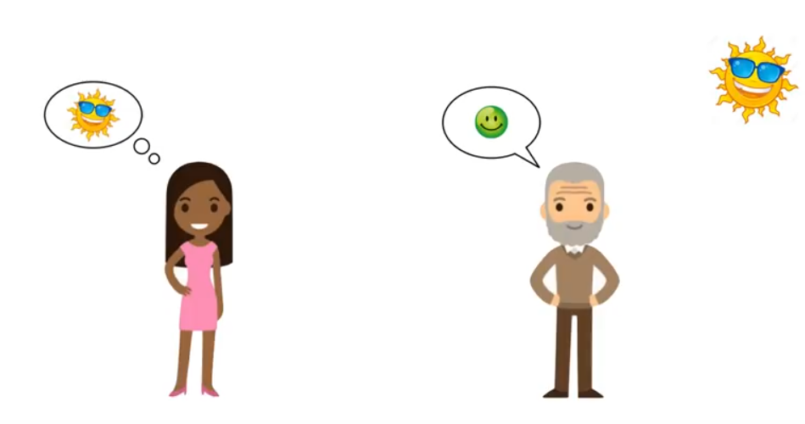
Hidden markov models

Slide 6
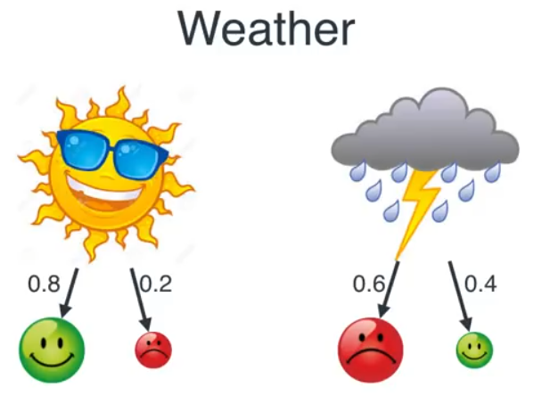
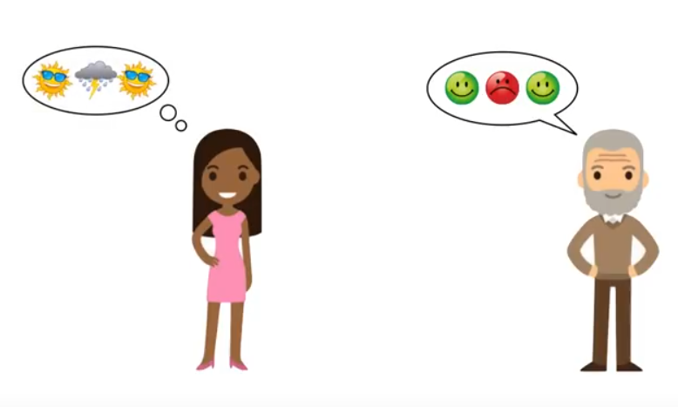
Contd..

Slide 7
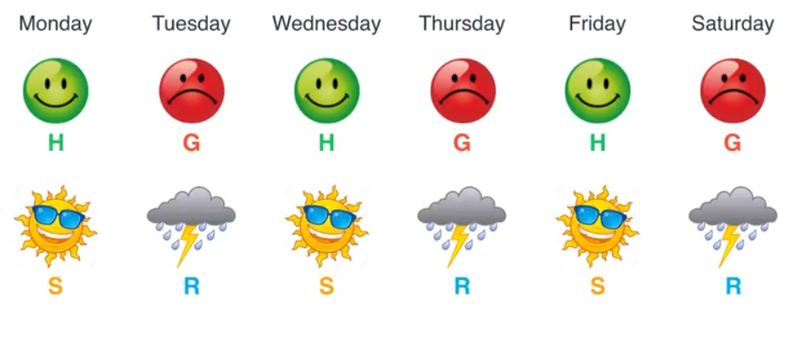
Contd..

Slide 8
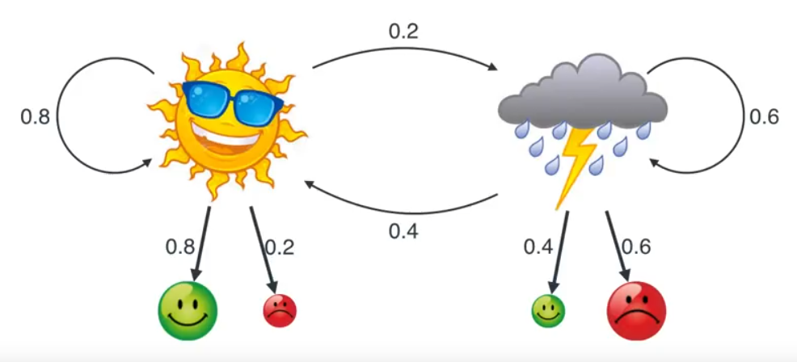
Contd..

Slide 9
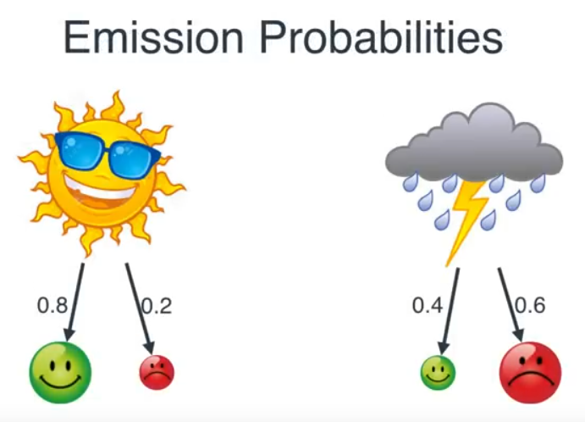
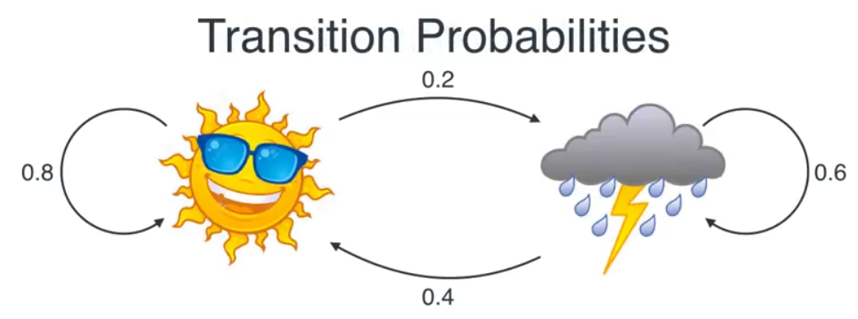
Contd..
How did we find these probabilities?
What’s the probability that a random day is sunny or rainy?
If Bob is happy today, what is the probability it is sunny or rainy?
If for three days Bob is happy, Grumpy, Happy, what was the weather?

Slide 10
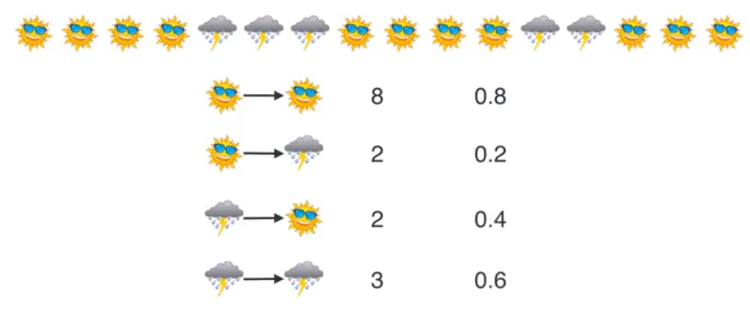
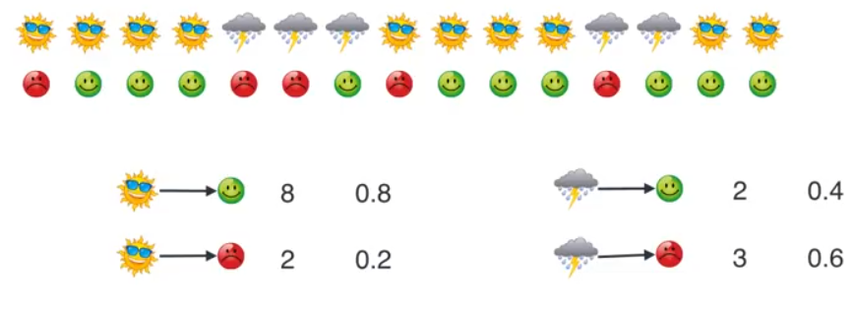
How did we find transition and emission probabilities

Slide 11
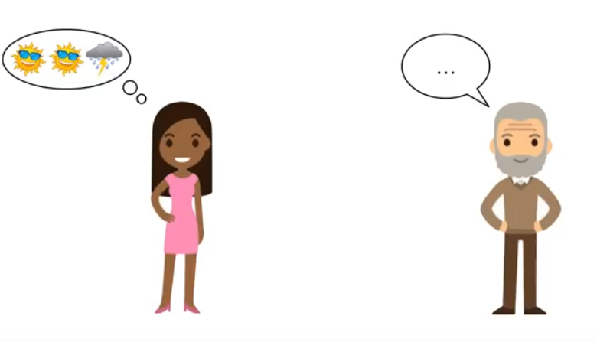
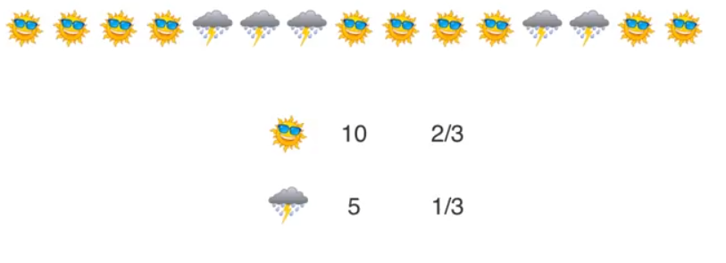
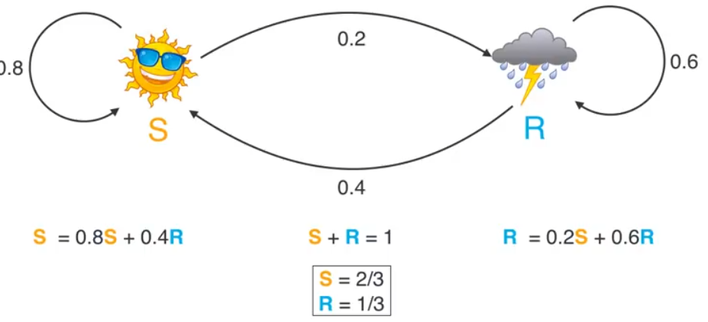
What is the probability that a random day is sunny/rainy

Slide 12
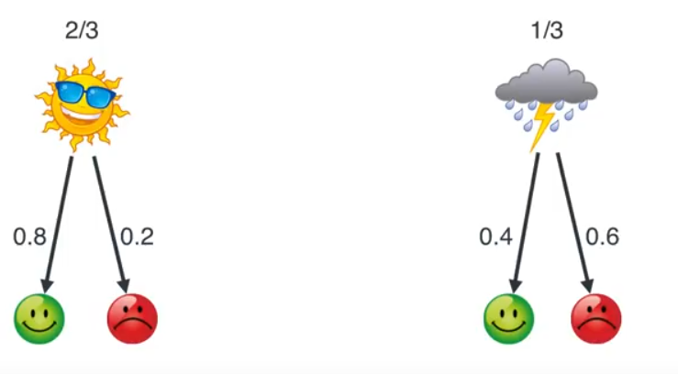
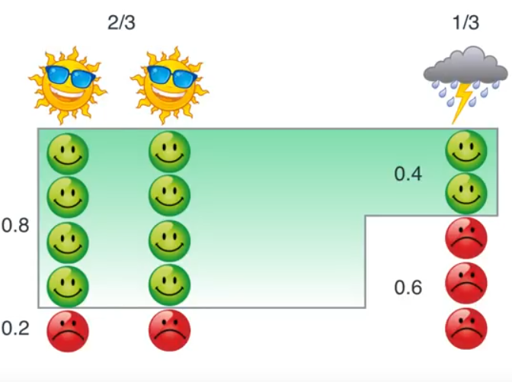
If Bob is happy today whats the probability that it is sunny or rainy
Note the probability changes from non information (2/3, 1/3)
Based on Bayes theorem
We are using any previous state history
Transition probability is not required

Slide 13
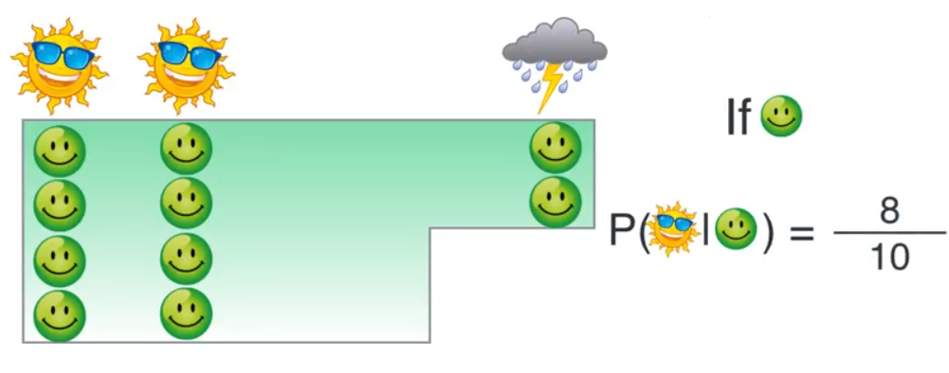
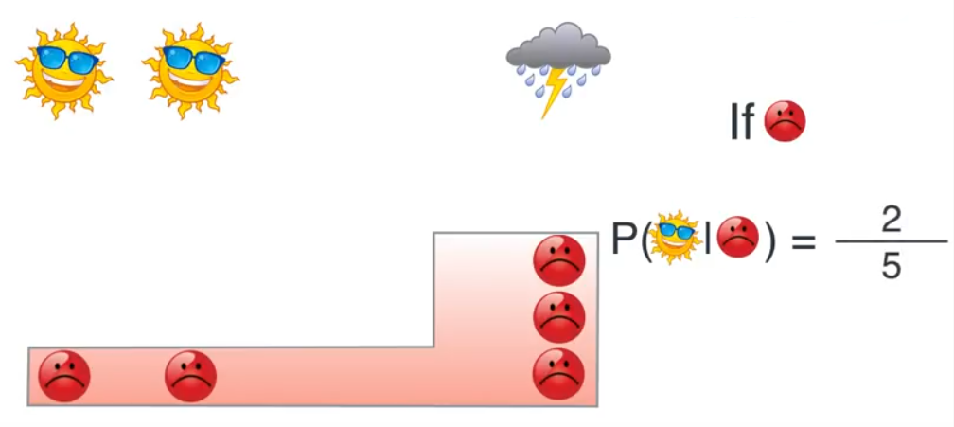
Contd..

Slide 14
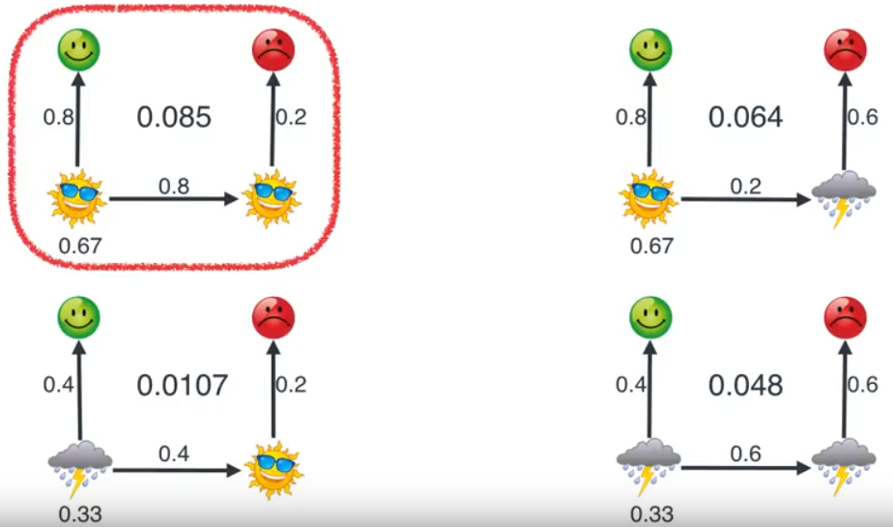
If for three days bob is happy, grumpy and happy, what could be the weather sequence
Lets first consider only for two days – happy, grumpy sequence

Slide 15
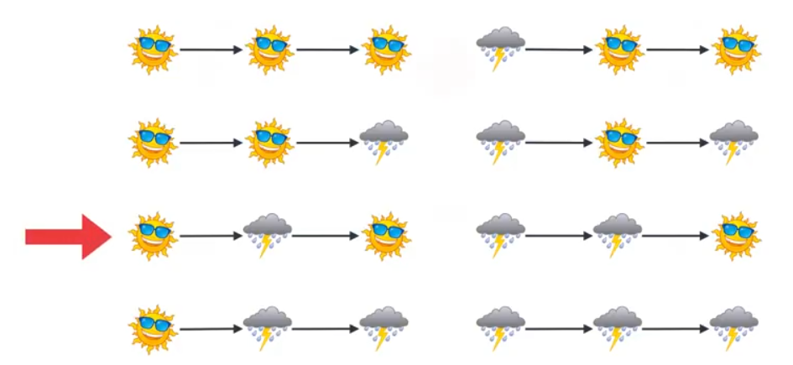
For 3 days 8 possible scenarios
2^3, for m number of states and n seq we have m^n possibilities

Slide 16
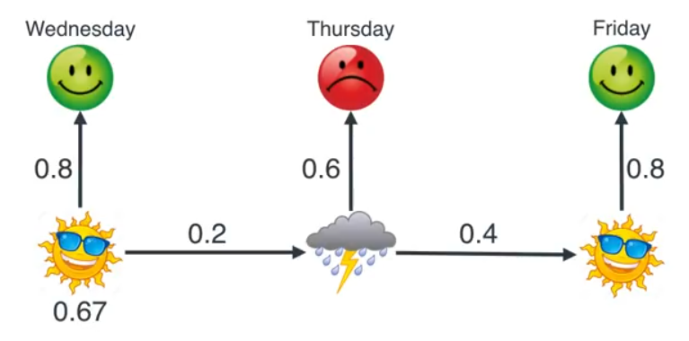
Contd..

Slide 17
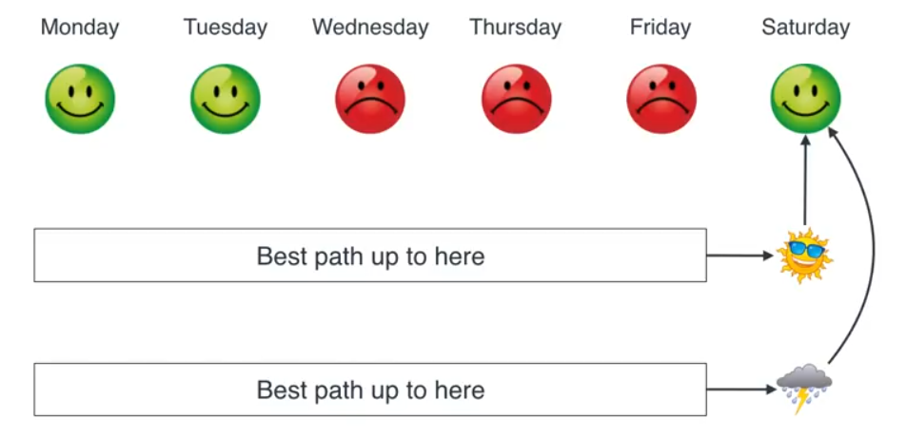
Insight to search the best seq
Using Viterbi algorithm, we can identify the most likely sequence of hidden states given the observation

Slide 18
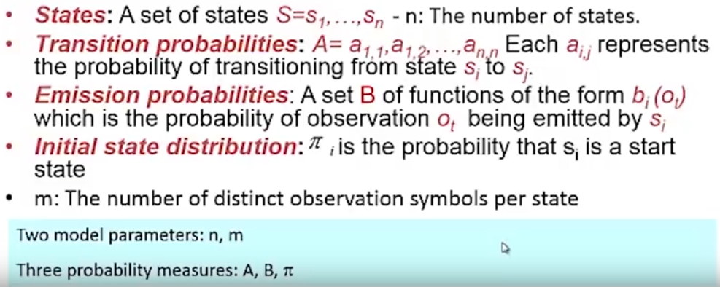
HMM - formalization

Slide 19
Viterbi algorithm

Slide 20
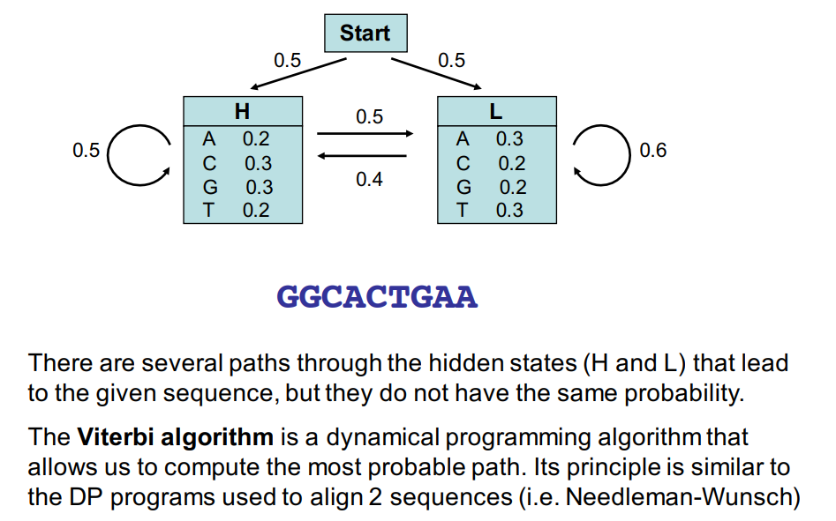
Contd..

Slide 21
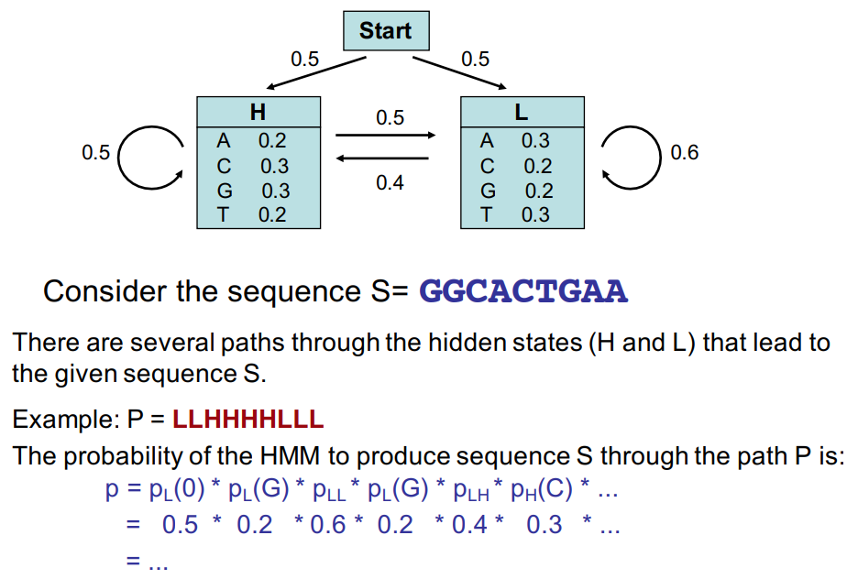
Viterbi algorithm

Slide 22
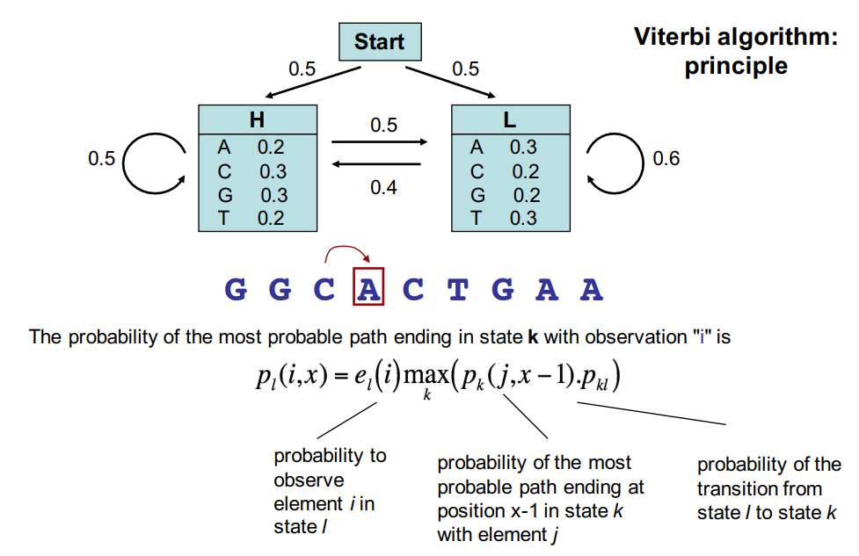
Contd..

Slide 23
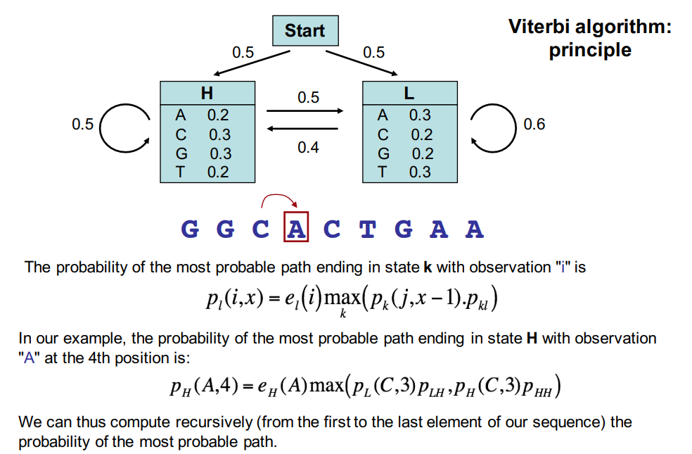
Contd..

Slide 24
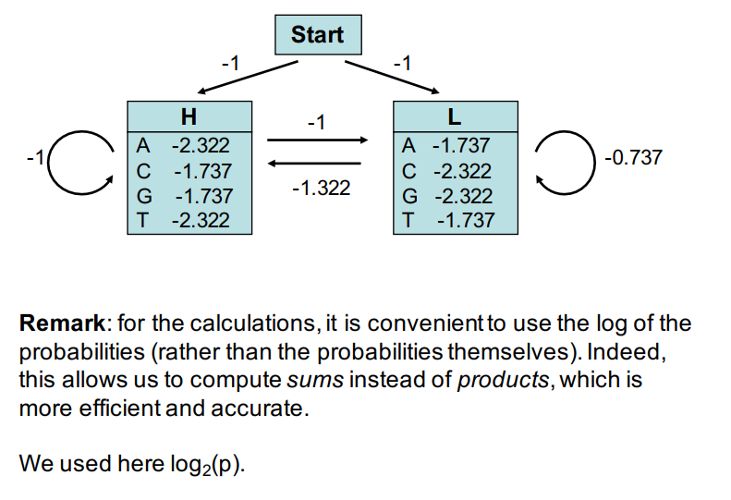
Contd..

Slide 25
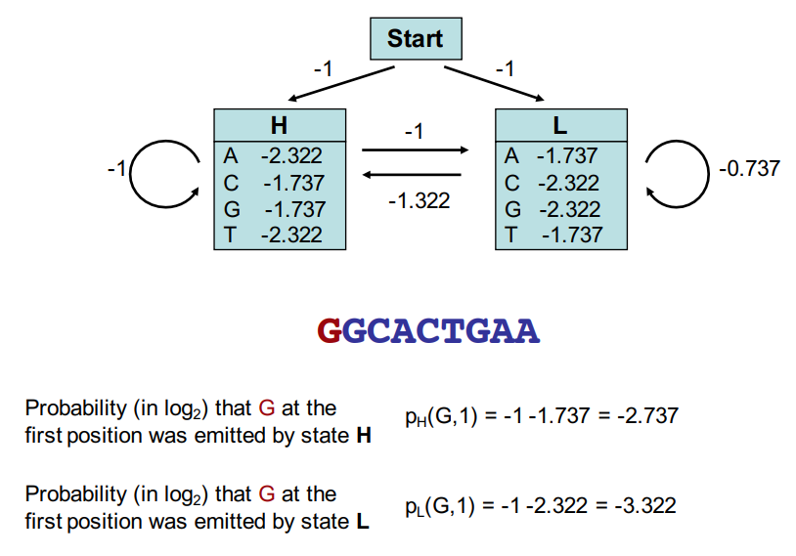
Contd..

Slide 26
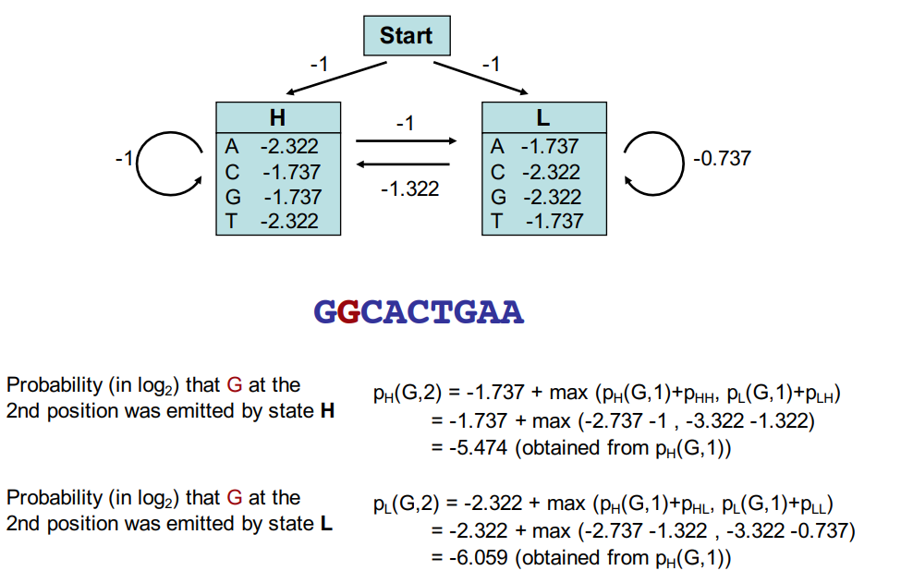
Contd..

Slide 27
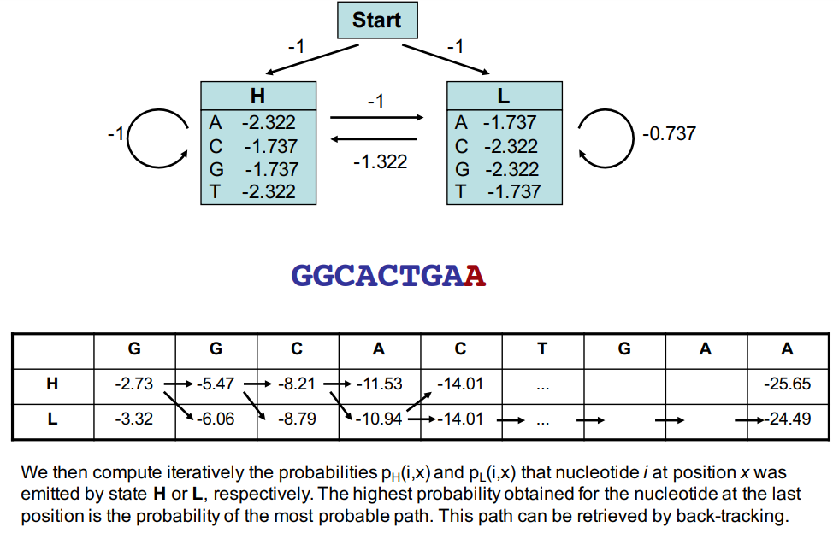
Contd..

Slide 28
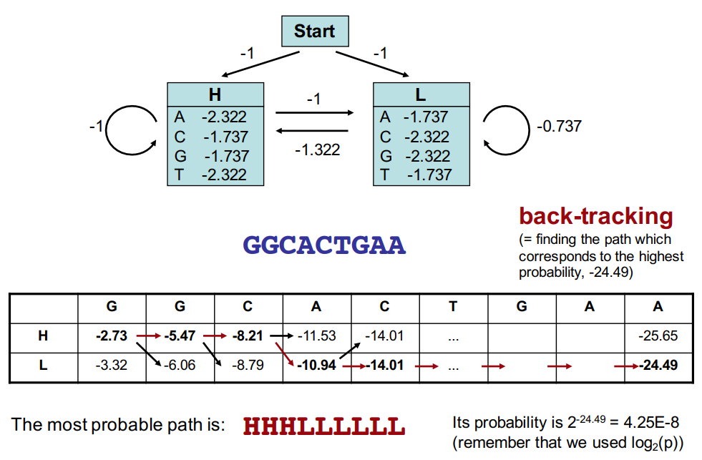
Contd..

Slide 29
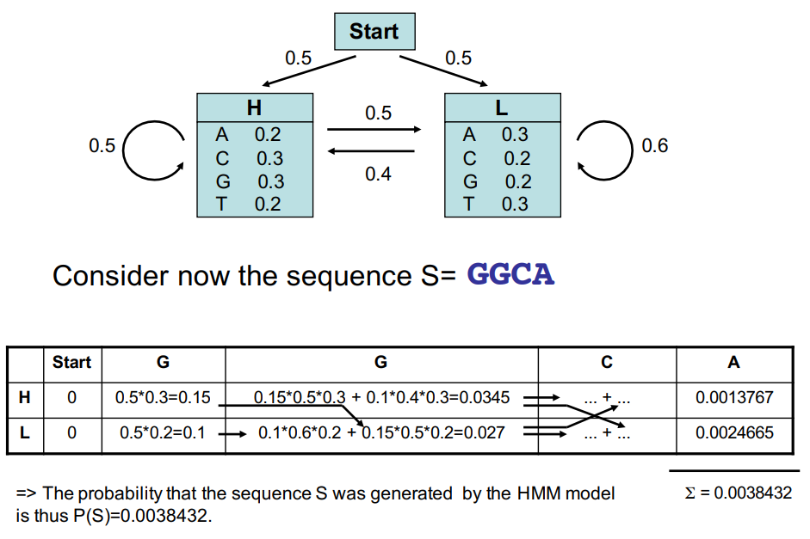
Contd..

Slide 30
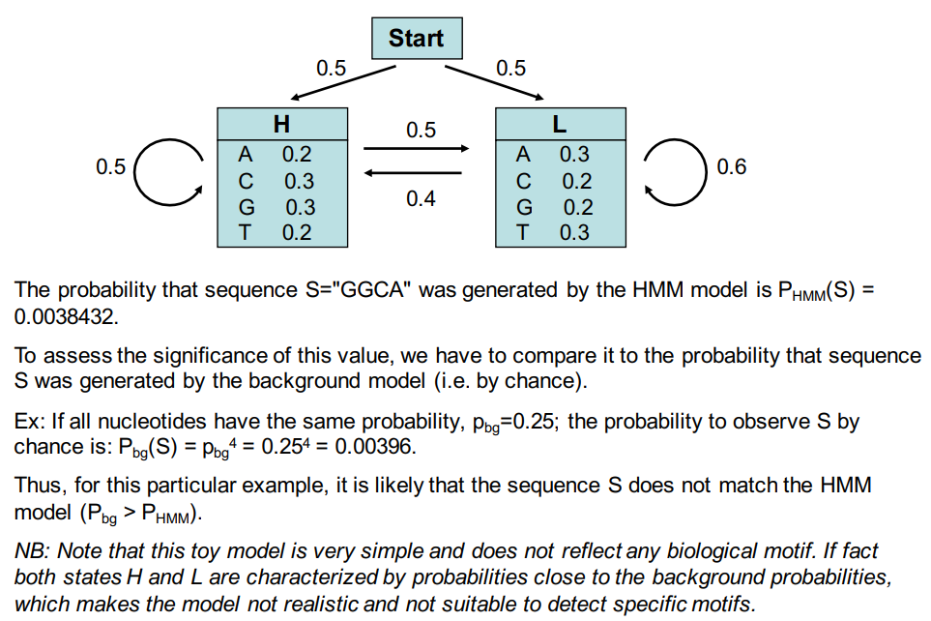
Contd..

Slide 31
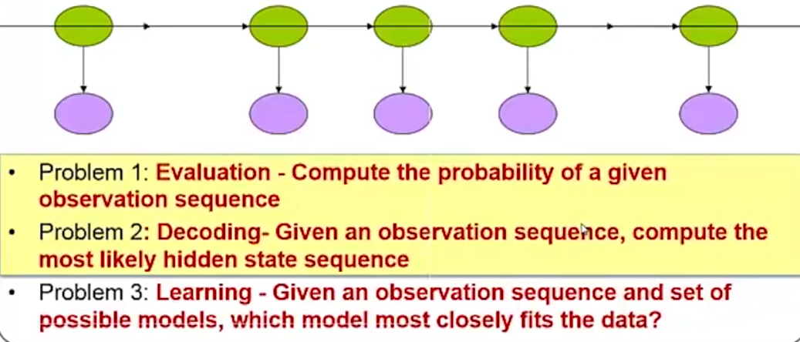
What are the three problems HMM can solve?

Slide 32
Application
Asset returns shows non-stationarity – mean and variance change over time
If we assume these asset returns behave differently during different economic scenarios we have a hidden markov model application
So our goal will be using HMM predict likely regime (economic scenario) and their associated mean, variance property
We will consider three observable variables – underlying asset returns, Ted spread (10 year – 2 year CMS), and the 10 year – 3 months CMS

Slide 33
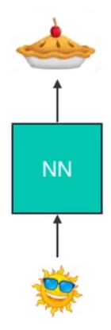
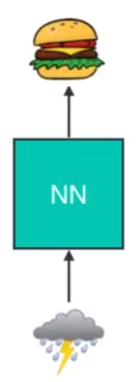
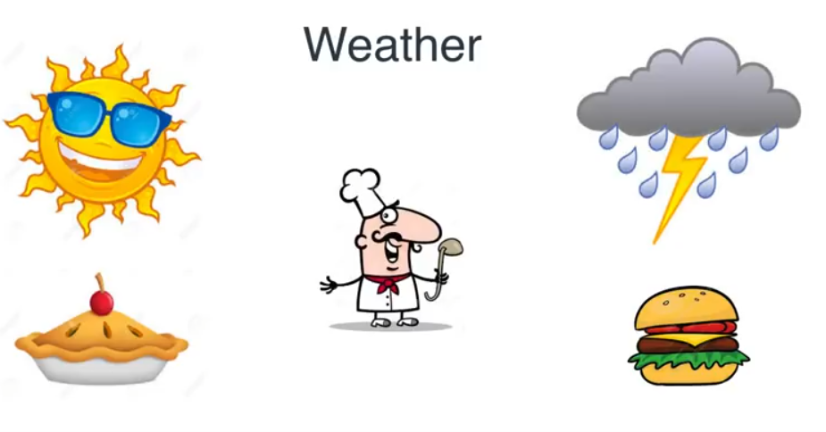
What we have understood so far about NN
Lets assume we have a cook who cooks according to weather
How do we model this using NN?

Slide 34
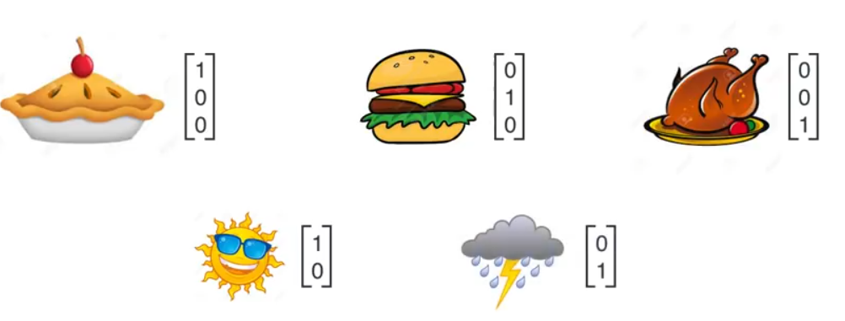
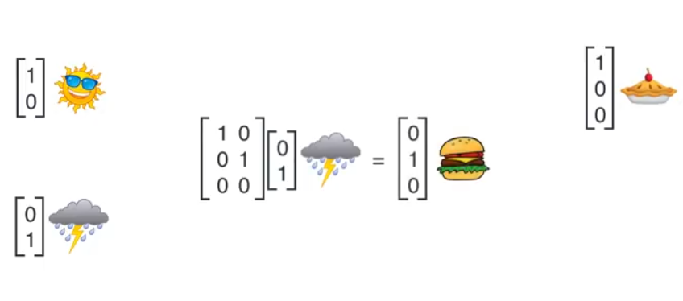
From symbolic representation to vector representation
Within the NN it is mainly a matrix multiplication
They are linear map without any activation function

Slide 35
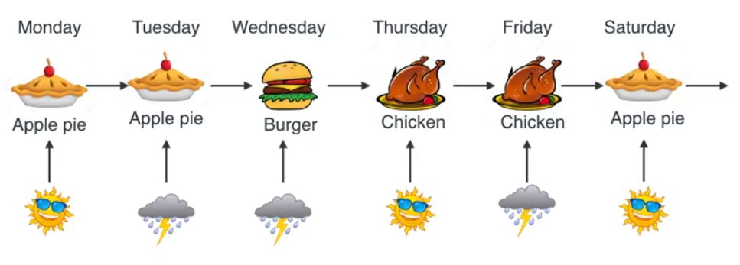
What happens for the following scenario
Standard NN cannot do this
This is exactly why RNN was developed

Slide 36
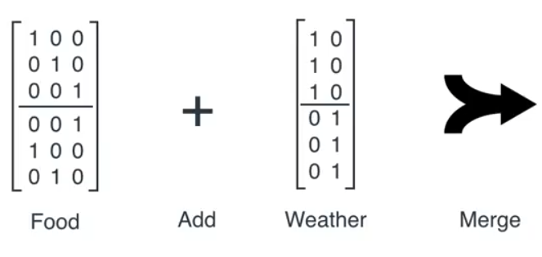
How to solve this using matrix

Slide 37
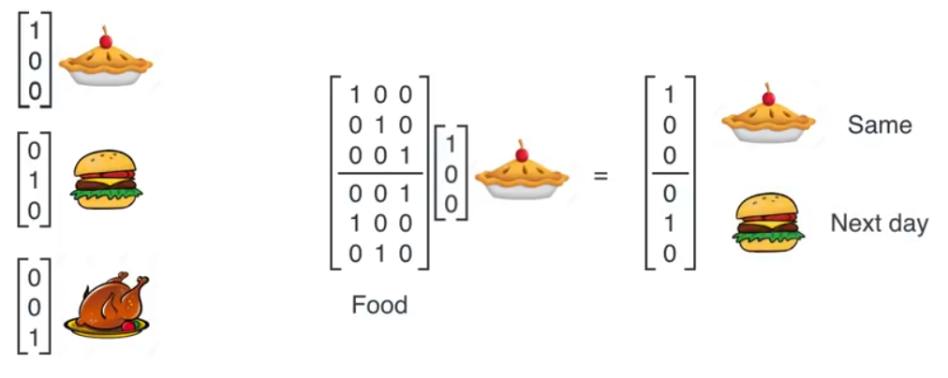
Food matrix

Slide 38
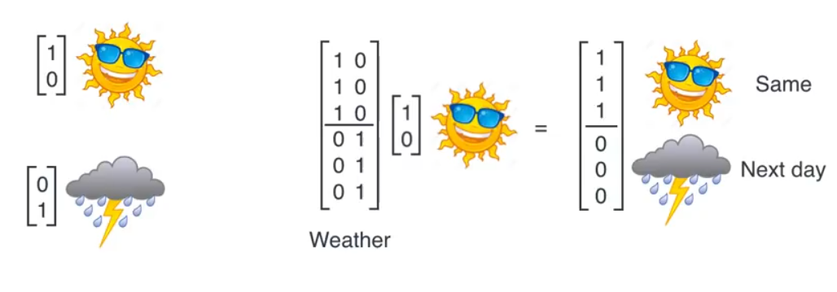
Weather matrix

Slide 39
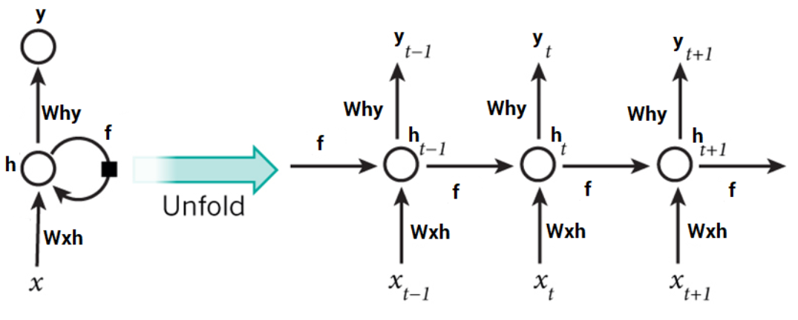
RNN
With the traditional MLP architecture the network only sees the current input
For sequencing we need a feedback loop that will help the NN to look into the previous input in some form
Below is a RNN architecture

Slide 40
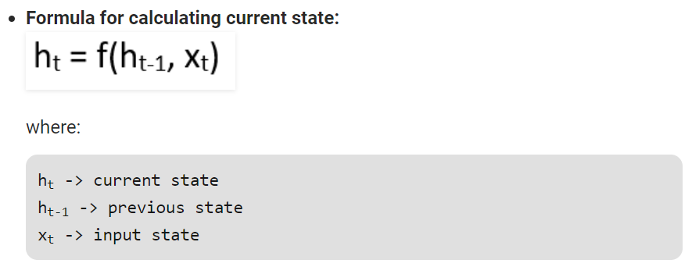
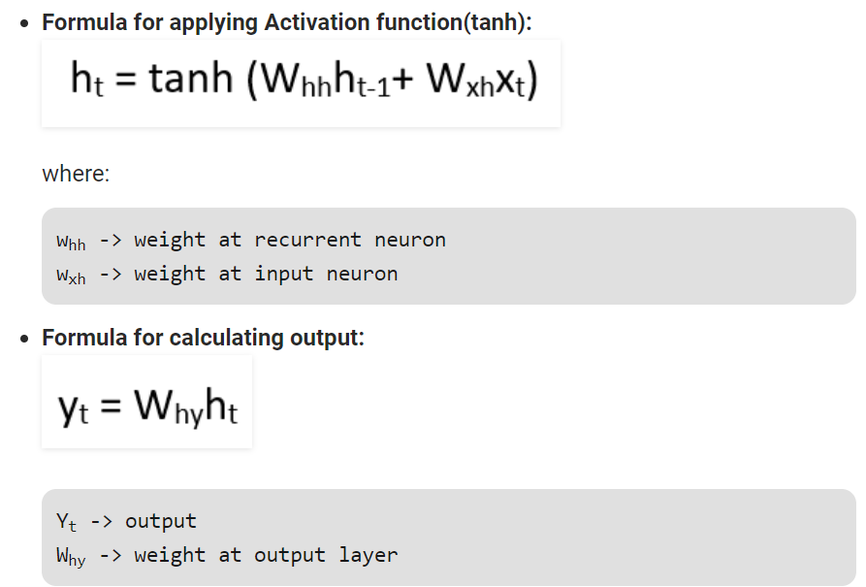
Contd..
Note how the activation function has 2 parts
One part is for hidden state
And one for recurrent

Slide 41
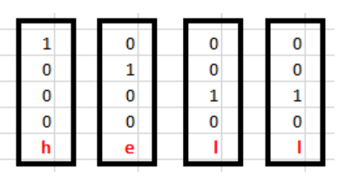
A detailed example
Assume we have a vocabulary {h,e,l,o}
We use one hot encoding
H = {1 0 0 0}, e = {0 1 0 0}, l = {0 0 1 0}, 0 = {0 0 0 1}
We want the network to learn for the word hell
So the token sequence will be h, e, l, l
In terms of vector

Slide 42
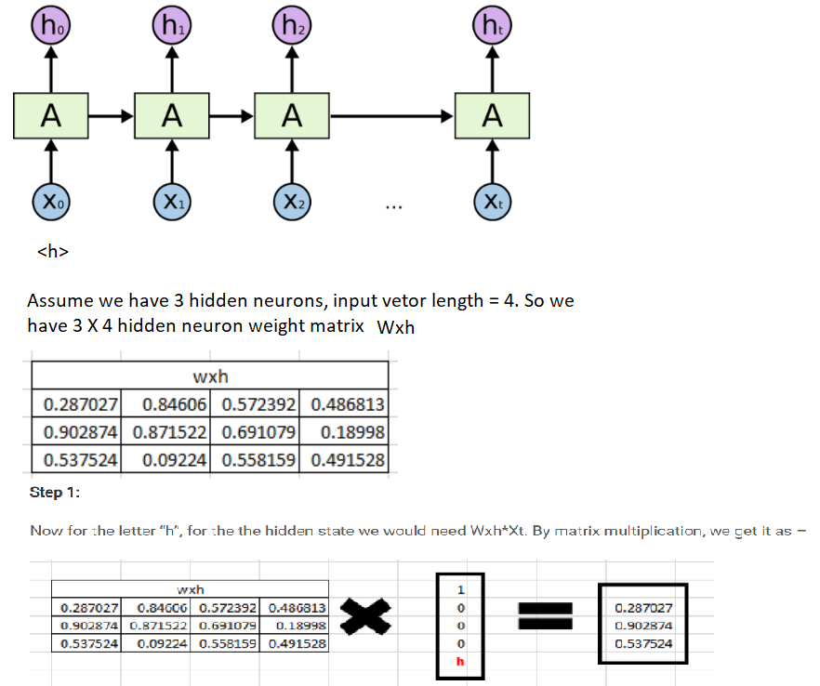
Contd..

Slide 43
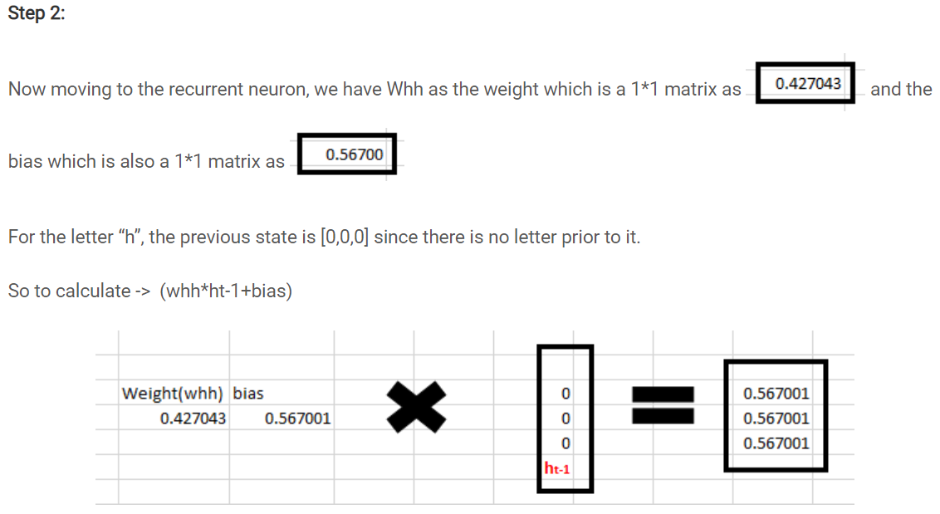
Contd..

Slide 44

Contd..

Slide 45

Contd..

Slide 46

Contd..

Slide 47

Contd..

Slide 48

Contd..

Slide 49

Contd..

Slide 50


RNN as a language model

Slide 51

Different ways of unrolling

Slide 52

Unrolled NN is a kind of feedforward network

Slide 53

Machine translation - Encoder decoder model
Encoder reads and encode the source sentence into a fixed length vector
Decoder then output a translation from the encoded vector (context vector)
They are trained jointly
Issue is context vector is of fixed length?
What if the input sentence is really long?

Slide 54

Contd..
We can generate a dynamic context vector
Encode info into sequence of vectors not in a single context vector
Choose a subset of these vectors adaptively while decoding the translation

Slide 55

Attention mechanism

